Slide 1
Goal-Based Software Measurement Framework
Chapter 3

Slide 2
GQM Review
Goal: List major goals of development or maintenance project.
Question: Derive from each goal the questions that must be answered to determine if the goals are being met.
Metrics: Decide what must be measured in order to be able to answer the questions adequately.
Notes:
EXAMPLE 3.2

Slide 3
Example: AT&T’s GQM
AT&T developers wanted to know the effectiveness of their software inspections. In particular, managers needed to evaluate the cost of the inspections against the benefits received. To do this, they measured the average amount of effort expended per thousand lines of code reviewed.
Goal: Better code base inspection
Subgoals:
A Better inspection planning: [Plan]
B Better monitor and control of the code: [Control]
C Improving code inspection: [Improve]
Notes:
EXAMPLE 3.2
what kind of information would help us to understand, control, or improve the process.

Slide 4
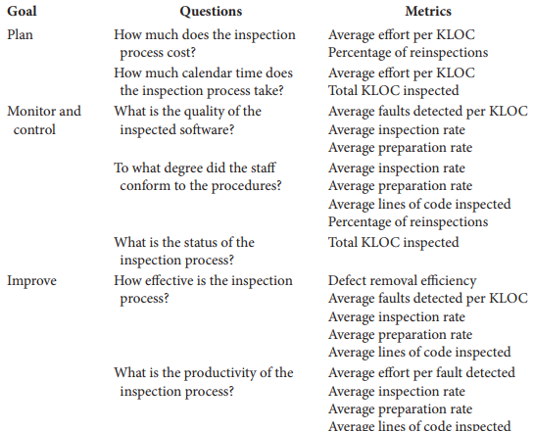
AT&T’s GQM Overview
Notes:
For instance, the average preparation rate is a function of the total number of lines of code inspected, the preparation time for each inspection, and the number of inspectors. A model of the metric expresses the average preparation rate as an equation. First, the preparation time for each inspection is divided by the number of inspectors; then, the sum over all inspections is calculated and used to normalize the total number of lines of code

Slide 5
Example: HP’s GQM
Three goals:
A: Maximize customer satisfaction
B: Minimize engineering effort and schedule
C: Minimize defects

Slide 6
Case Study: HP’s GQM
GA: Maximize customer satisfaction.
QA1: What are the attributes of customer satisfaction?
MA1: Functionality, usability, reliability, performance, supportability.
QA2: What are the key indicators of customer satisfaction?
MA2: Survey, quality function deployment (QFD).
QA3: What aspects result in customer satisfaction?
MA3: Survey, QFD.
QA4: How satisfied are customers?
MA4: Survey, interview record, number of customers severely affected by defects.
QA5: How many customers are affected by a problem?
MA5: Number of duplicate defects by severity

Slide 7
Case Study: HP’s GQM
GA: Maximize customer satisfaction.
QA6: How many problems are affecting the customer?
MA6-1: Incoming defect rate
MA6-2: Open critical and serious defects
MA6-3: Defect report/fix ratio
MA6-4: Post-release defect density
QA7: How long does it take to fix a problem?
MA7-1: Mean time to acknowledge problem
MA7-2: Mean time to deliver solution
MA7-3: Scheduled vs. actual delivery
MA7-4: Customer expectation of time to fix

Slide 8
Case Study: HP’s GQM
GA: Maximize customer satisfaction.
QA8: How does installing a fix affect the customer?
MA8-1: Time customers operation is down
MA8-2: Customers effort required during installation
QA9: Where are the bottlenecks?
MA9: Backlog status, time spent doing different activities

Slide 9
Case Study: HP’s GQM
GB: Minimize engineering effort & schedule.
QB1: Where are the worst rework loops in the process?
MB1: Person-months by product-component-activity.
QB2: What are the total life-cycle maintenance and support costs for the product?
MB2-1: Person-months by product-component-activity.
MB2-2: Person-months by corrective, adaptive, perfective maintenance.
QB3: What development methods affect maintenance costs?
MB3: Pre-release records of methods and post-release costs.

Slide 10
Case Study: HP’s GQM
GB: Minimize engineering effort & schedule.
QB4: How maintainable is the product as changes occur?
MB4-1: Incoming problem rate
MB4-2: detect density
MB4-3: Code stability
MB4-4: Complexity
MB4-5: Number of modules changed to fix one detect
QB5: What will process monitoring cost and where are the costs distributed?
MB5: Person-months and costs
QB6: What will maintenance requirements be?
MB6-1: Code stability, complexity, size
MB6-2: Pre-release defect density

Slide 11
Case Study: HP’s GQM
GB: Minimize engineering effort & schedule.
QB7: How can we predict cycle time, reliability, and effort?
MB7-1: Calendar time
MB7-2: Person-month
MB7-3: Defect density
MB7-4: Number of detects to fix
MB7-5: Defect report/fix ratio
MB7-6: Code stability
MB7-7: Complexity
MB7-8: Number of lines to change

Slide 12
Case Study: HP’s GQM
GB: Minimize engineering effort & schedule.
QB8: What practices yield best results?
MB8: Correlations between pre-release practices and customer satisfaction data
QB9: How much do the maintenance phase activities cost?
MB9: Personal-months and cost
QB10: What are major cost components?
MB10: Person-months by product-component-activity
QB11: How do costs change over time?
MB11: Track cost components over entity maintenance life-cycle.

Slide 13
Case Study: HP’s GQM
GC: Minimize defects
QC1: What are key Indicators of process health and how are we doing?
MC1: Release schedule met, trends of defect density, serious and critical defects.
QC2: What are high-leverage opportunities for preventive maintenance?
MC2-1: Defect categorization
MC2-2: Code stability
QC3: Are fixes effective with less side effects?
MC3: Defect report/fix ratio

Slide 14
Case Study: HP’s GQM
GC: Minimize defects
QC4: What is the post-release quality of each module?
MC4: Defect density, critical and serious detects.
QC5: What are we doing right?
MC5-1: Defect removal efficiency
MC5-2: Defect report/fix ratio
QC6: How do we know when to release?
MC6-1: Predicted defect detection and remaining defects.
MC6-2: Test coverage.

Slide 15
Case Study: HP’s GQM
GC: Minimize defects
QC7: How effective is the development process in preventing defects?
MC7: Post-release detect density
QC8: What can we predict will happen post-release based on pre-release data?
MC8: Corrections between pre-release complexity, defect density, stability, and customer survey data.
QC9: What defects are getting through and there causes?
MC9: Detect categorization

Slide 16
SEI GQM
The goal-driven process model defined by Software Engineering Institute (SEI) in 1996.
This GQM process model defines ten steps to fulfill the task of developing a software measurement plan.
It focuses on the whole process of converting a business goal into several specific measurement goals and refining to a software measurement plan.
This process model is easy to understand and follow in that it works in a pipeline style, which means that the output of a step is the input of the next step [Chen 2003].
Notes:
https://resources.sei.cmu.edu/asset_files/Handbook/1996_002_001_16436.pdf

Slide 17






GQ(I)M Concept
Goal – Question – Indicator – Metrics
A methodology to convert a business goal into a measurement plan.
Business Goal
Measurement Plan
Measurement Plan: 1…………………….
2…………………….
GQIM Process
Business Goal: Reduce cost?

Slide 18
GQ(I)M: Percepts
The GQ(I)M method is based on 3 precepts, and it consists of 10 steps
The three precepts are:
Measurement goals are derived from business goals
Evolving mental models provide context and focus
GQ(I)M translates informal business goals into executable measurement structures

Slide 19
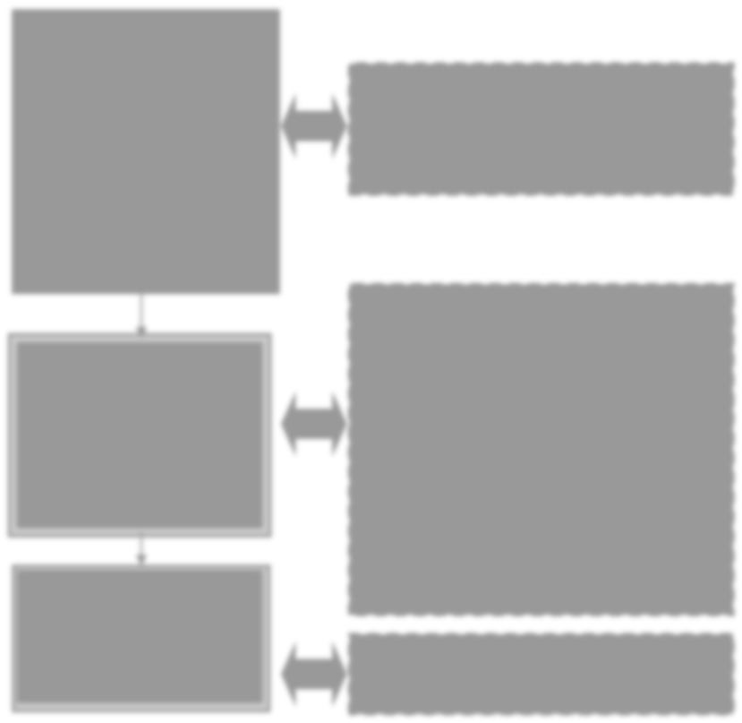
GQ(I)M: Process
1) Identify Business Goals
BG1
2) Identify what to know
3) Identify subgoals
MG1
MG1
4) Identify entities & attributes
5) Formalize Measurement Goals
G
MG1
MG1
Define Indicators
6) Identify questions and indicators
Q
Q1
Q2
Q3
7) Identify measures
8) Define measures
I
I1
I2
I3
I4
Create Action Plan
M
M 1
M2
M 3
9) Identify actions
Action Plan
10) Create plan

Slide 20
GQ(I)M: Steps
Identify business goals
Identify what you want to know or learn
Identify subgoals
Identify entities and attributes related to subgoals
Formalize measurement goals
Identify quantifiable questions and indicators that will be used to achieve measurement goals
Identify data elements that will be collected to construct the indicators to answer questions
Define measures to be used, and make these definitions operational
Identify actions that will be taken to implement the measures
Prepare a plan for implementing the measures

Slide 21
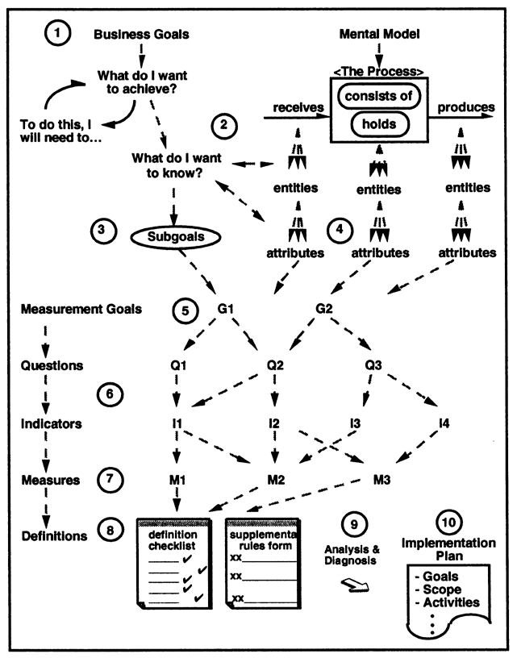
GQ(I)M
The GQ(I)M method begins with identifying business goals and breaking them down into manageable subgoals.
It ends with a plan for implementing well-defined measures and indicators that support the goals.
It can also maintain traceability back to the business goals.

Slide 22
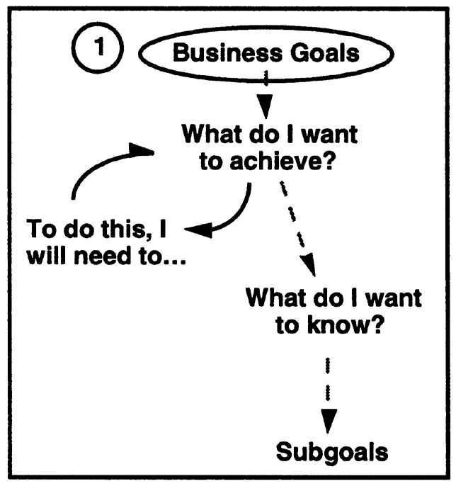
Step 1: Identify Business Goals
The business goal can be initiated at any organizational level
Examples:
Reduce time to market (TTM)
Improve customer satisfaction
Improve quality of the code
1
2

Slide 23
Templates for goal definition
Purpose: To (characterize, evaluate, predict, motivate, etc.) the (process, product, model, metric, etc.) in order to (understand, assess, manage, engineer, learn, improve, etc.) it. Example: To evaluate the maintenance process in order to improve it.
Perspective: Examine the (cost, eﬀectiveness, correctness, defects, changes, product measures, etc.) from the viewpoint of the (developer, manager, customer, etc.) Example: Examine the cost from the viewpoint of the manager.
Environment: The environment consists of the following: process factors, people factors, problem factors, methods, tools, constraints, etc. Example: The maintenance staﬀ consists of poorly motivated programmers who have limited access to tools

Slide 24
Step 1: Identify Business Goals
The output of Step 1 is a sorted checklist of business goals (i.e., management goals, development goals, and maintenance goals, etc.) along with their definitions.
If more than one goal: generate plan for each goal separately.
Typical expansion rate: 1-4 times
Business Goal #1:
Business Goal #2:
Business Goal #3:

Slide 25

Example
Primary Business Goal:
Saving money by improving productivity of software development team
Examine the effect of productivity of software development team on project costs
(Analyzed from project manager’s perspective)

Slide 26
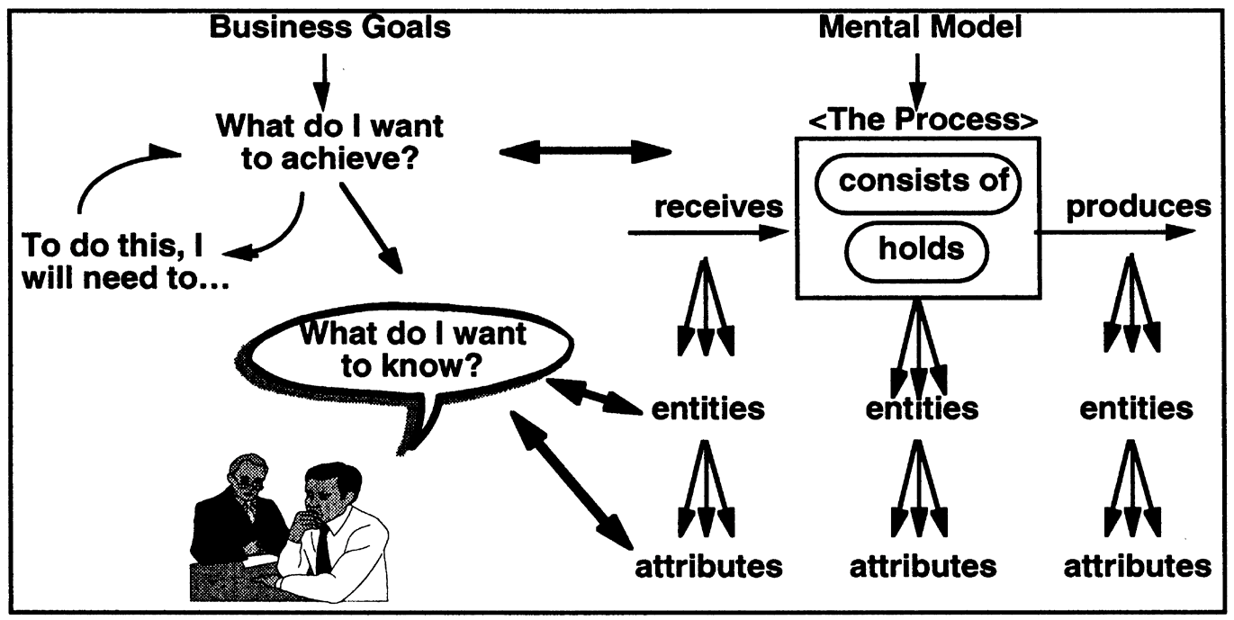
Step 2: Identify What to Know

Slide 27
Step 2: Identify What to Know
Identifying what is needed to be known in order to understand, assess, predict, or improve the activities related to achieving goals by asking questions such as:
“What activities do we manage or execute?”
“What do we want to achieve or improve?” and
by completing statements such as
“To do this, we will need to…”
Repeat these questions several times and break top-level goals down into specific things should be accomplished and issues that are needed to be addressed.
The output of this step is the entity-question checklist.

Slide 28
Entity- Question Checklist
Start with one of the top-level goals identified in Step 1.
Identify the persons or groups whose concerns will be addressed. (i.e., manager, developer, customer, etc.) This defines the perspective and the roles that you and the team will assume in Tasks 3 through 6 here and in the remaining steps of the process.
Create rough sketches of the relevant processes that you, in your role, manage or affect. As you do this, be guided by what you want to achieve and the issues you will have to address to achieve it.

Slide 29
Entity- Question Checklist
List the important things (entities) in your processes that you, in your role, manage or influence. Make sure that you address the four kinds of process entities below:
Inputs and resources
Products and by-products
Internal artifacts such as inventory and work in process
Activities and flowpaths
You may also want to list some of the environmental entities outside your processes that affect your work.

Slide 30
Entity- Question Checklist
For each entity, list questions that, if answered, would help you, in your role, plan and manage progress toward your goals. For example:
How big is it?
How much is there?
How many components?
How fast is it?
How long does it take?
How much does it cost?

Slide 31
Entity- Question Checklist
Step back and look at your process as a whole to see if anything is missed. By asking questions such as:
Is the process stable?
What limits our capability?
What determines success?
What do our customers want?
Where is backlog occurring?
What could go wrong?
How is it performing now?
What determines quality?
What things can we control?
What limits our performance?
You may discover additional entities whose properties may be worth measuring.
Repeat Tasks 1–6 for your other goals.

Slide 32
Example
Entities of Interest |  | Questions Related to Business Goal
Inputs and Resources | People | How productive are people right now? In what areas do they need improvement? Extent of individual morale? Do we need more team members? Is our staff over-worked?
 | Computer Aided Software Engineering Tools | Are the tools sufficient or do they need to be upgraded? How do tools affect productivity?
 | Subcontractors | Would subcontracting aid our productivity? Is it worth it?
 | Customer Requests for Change | How much do changes in the project affect productivity?

Slide 33
Example
Entities managed by a project manager | Questions related to customer satisfaction
Internal artifacts customer change requests (work in process) | How large is our backlog of customer change requests? Where are the backlogs occurring?

Slide 34
Example
Entities of Interest |  | Questions Related to Business Goal
Activities and Flow Paths | Development | Are we using the most productive development methodology? Do we effectively structure the development team? Are we spending too much time in the development phase?
 | Testing | Are we using manual testing or automated testing? Are the tests finding enough defects? Are we spending too much time on testing?
 | Fixing | Is the response time for fixing bugs reasonable? Are high-priority changes getting implemented in a timely fashion? Are we spending too much time debugging?

Slide 35
Example
Entities of Interest |  | Questions Related to Business Goal
Products and By- products | Documents | Are the documents we produce readable? Is it possible to trace system features from one document to the next?
 | Source Code | Is the source code consistent with the documents? Is the source code error free? Does source code follow programming standards?
 | Plans | Do the plans change too much?
 | Budget | Do we have enough money to increase salaries and invest in tools?

Slide 36
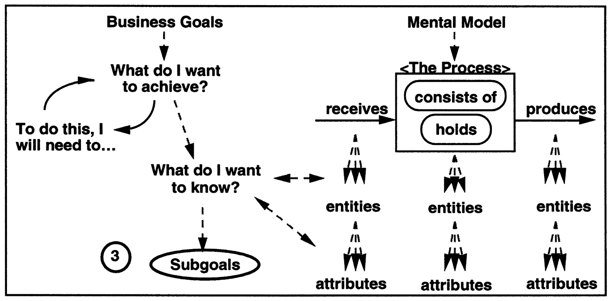
Step 3: Identify Subgoals

Slide 37
Step 3: Identify Subgoals
Grouping related questions helps identify subgoals
In Step 3, you identify the questions that you have about the entities, then group them and identify the issues they address.
Then groupings of issues and questions translate naturally into candidate subgoals.
Sometimes, you may find several issues mapping into a single subgoal, or single issues mapping into several subgoals.

Slide 38
Example
Questions Related to Development Team Productivity
GROUPING #1 (People) | How productive are our employees right now? In what areas do they need improvement? Extent of overall office morale? Do we need more team players? Is our staff over-worked?
GROUPING #2 (Development) | Are the tools sufficient or do they need to be upgraded? How do tools affect productivity? Would subcontracting aid our productivity? Is it worth it? Are we using the most productive development methodology? Are we spending too much time in the development phase? Is the source code consistent with the documents? Is the source code error free? Does source code follow programming standards? Do we have enough money to invest in tools?

Slide 39
Example
Questions Related to Development Team Productivity
GROUPING #3 (Response to Change) | How much do changes in the project affect productivity? Do the plans change too much?
GROUPING #4 (Quality Assurance) | Are we using manual testing or automated testing? Are the tests finding enough defects? Are we spending too much time on testing? Is the response time for fixing bugs reasonable? Are high-priority changes getting implemented in a timely fashion? Are we spending too much time debugging? Do we need better testing to be done? Are the documents we produce readable? Is it possible to trace system features from one document to the next?

Slide 40
Example
Derived Subgoals (from Project Manager’s Perspective)
Subgoal #1 Improve performance of staff
Subgoal #2 Improve code development processes
Subgoal #3 Minimize the negative effects of project changes in productivity
Subgoal #4 Improve quality assurance

Slide 41
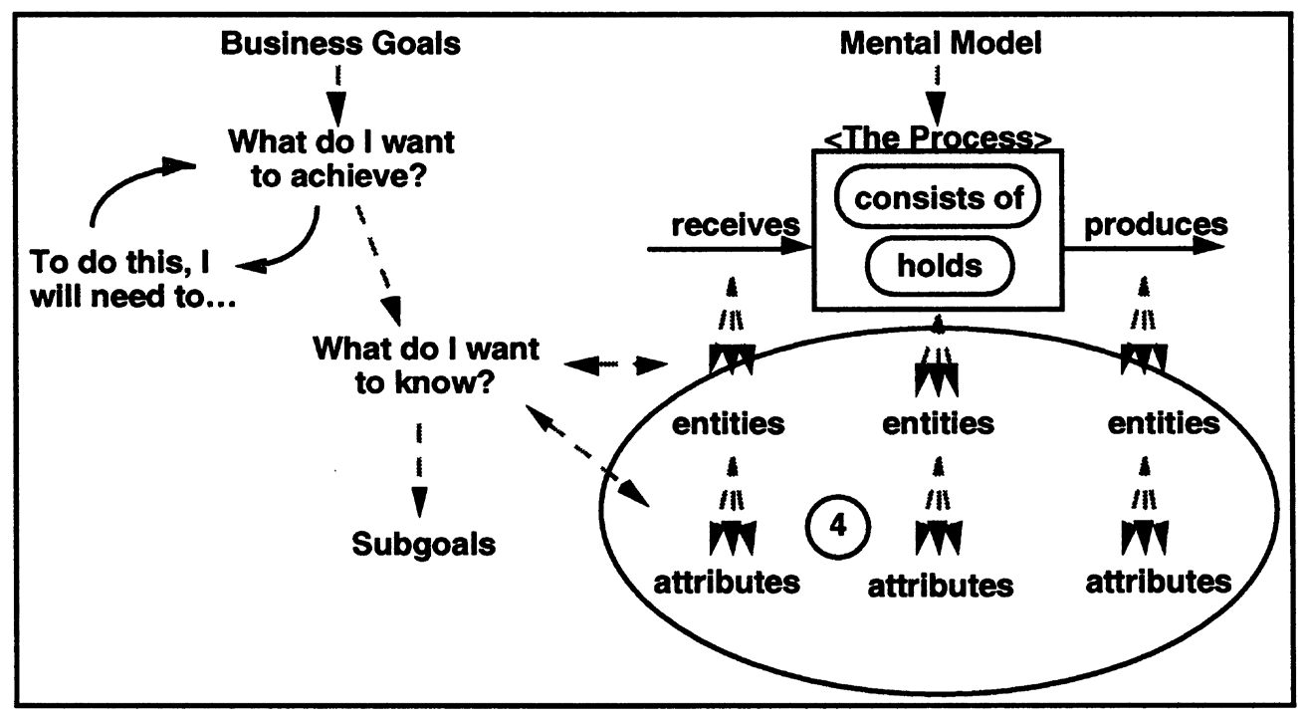
Step 4: Identify Entities & Attributes
4

Slide 42
Step 4: Identify Entities & Attributes
Once having a list of questions, you should examine each question and identify entities implicit in it. Then list pertinent attributes associated with each entity.
Pertinent attributes are those which, if quantified, help answer your question or establish a context for interpreting the answers.
Pertinent attributes are usually cited in the question, either explicitly or implicitly.
List of entities and the attributes for each entity are the principal outputs of this step.
The attributes will become candidates for the things that should be measured.

Slide 43
Example
Subgoal 1: Improve the performance of our staff
Question 1:
Currently, how productive is our development team?
Entity:
Development team
Attributes:
Team personality factors
Team’s analysis and design techniques
Knowledge of programming languages

Slide 44
Example
Subgoal 1: Improve the performance of our staff
Question 2:
How is the overall office’s morale?
Entity:
Working Environment
Attributes:
Accommodations
Incentives
Extra-curricular activities
Hardware and software used
Work time to break time ratio
Workspace (room and desk size, ventilation)

Slide 45
Example
Subgoal 2: Improve Code Development Process
Question 1:
Are we spending too much time in the development phase?
Entity:
The development process
Attributes:
Average duration of development process, per line of code
Percentage of development process’ duration for average project
Company expectations for percentage duration of code development

Slide 46
Example
Subgoal 3: Minimize the negative effects of project changes in productivity
Question 1:
How much do changes in the project affect productivity?
Entity:
Set of change requests received from the customer
Attributes:
Number of change requests
Estimated total effort to satisfy change requests
Total effort for project

Slide 47
Example
Subgoal 4: Improve quality assurance
Question 1:
Are we using manual testing or automated testing?
Entity:
Testing method
Attributes:
Type (name of type)
Is used? Yes/no (a binary classification)

Slide 48
Example
Subgoal 4: Improve quality assurance
Question 2:
How effective are the tests? Are we spending too much time on testing?
Entity:
Testing
Attributes:
Volume number of tests scheduled
Progress
number of tests executed
number of tests passed

Slide 49
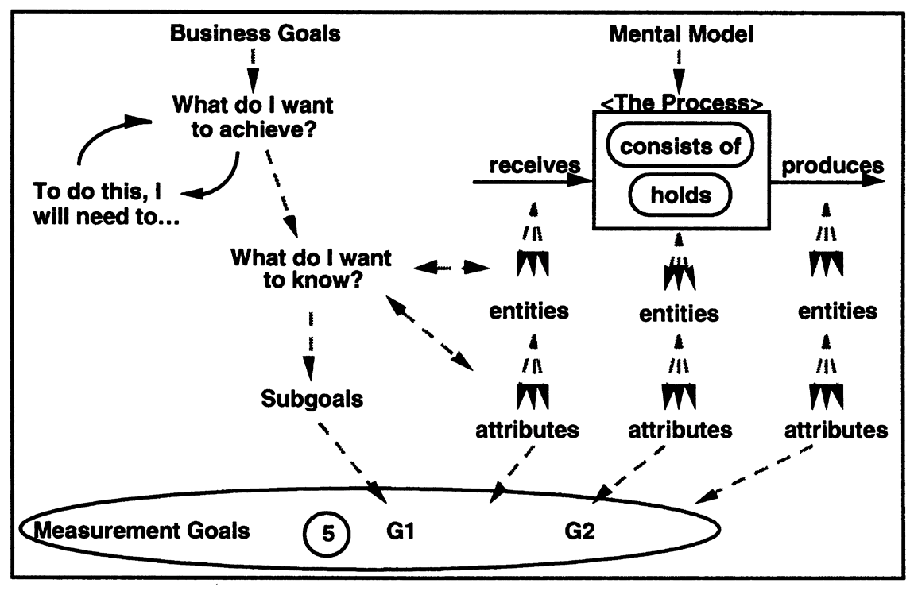
Step 5: Formalize Measurement Goals

Slide 50
What is a Measurement Goal?
Business goals (or subgoals) are usually represented by a phrase or sentence in natural language whereas a measurement goal (or subgoal) is a semi-formal representation of a business goal (or subgoal), composed of 4 components:
An object of interest (entity)
A purpose
A perspective
A description of environment & constraints
Traceability: Measurement goals should be traced back to the subgoals and business goals to show that they are consistent with the business objective.

Slide 51
Active & Passive Measurement Goals
Active measurement goals are directed toward controlling processes or causing changes to products, processes, resources, or environments. These are the kinds of goals that are found in project management and process improvement activities.
Passive measurement goals are meant to enable learning or understanding. Passive goals are often accomplished by characterizing objects of interest according to some productivity or quality model.

Slide 52
Active & Passive Measurement Goals: Examples
Active Goals
Meet the scheduled completion date
Reduce variability
Improve product reliability
Improve productivity of the process
Improve time-to-market
Reduce employee turnover
Passive Goals
Understand the current development process
Identify root causes
Identify capabilities and trends, so that we can better predict future performance
Understand relationships among attributes, so that we can develop models for predicting and estimating

Slide 53
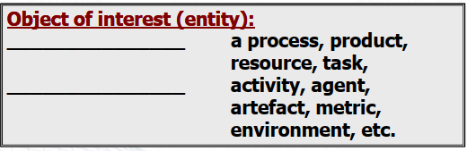
Measurement Goal: Object
Anything real or abstract, that we want to describe or know more about is a potential object for measurement.
An object is an entity we want to describe with measured values.

Slide 54
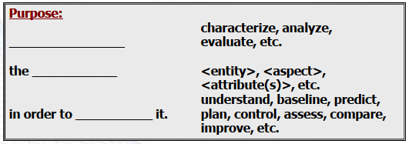
Measurement Goal: Purpose
Purpose of a measurement activity may be to understand, predict, plan, control, compare, assess, or improve some productivity or quality aspect of the object.
Examples include: cost, size, reliability, test coverage, responsiveness, peer review effectiveness, process compliance, time to market, quality, customer satisfaction.

Slide 55
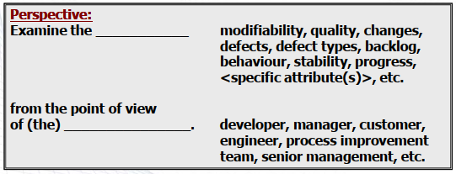
Measurement Goal: Perspective
The perspective identifies who is interested in the measurement results, such as: developer, maintainer, manager, or customer.
The perspective is stated to clarify the purpose of the measurement activity.

Slide 56
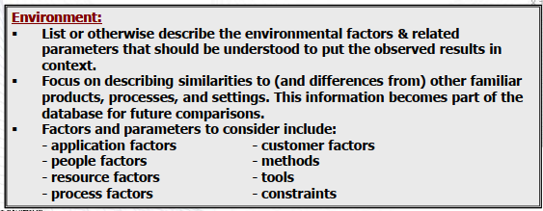
Measurement Goal: Environment
A description of environment provides a context for interpreting measurement results. The environment includes everything that affects or is affected by the object to be measured, such as time, resources, unusual performance criteria, etc., as well as constraints on the scope or time span of the measurement process itself.

Slide 57
Measurement Goal: Template
Template for measurement (sub)goal:
Object of interest:
Purpose:
the in order to it.
Perspective:
Examine the
from the point of view of (the) .
Environment:
, , , ,
, , , ,

Slide 58
Example
Object of Interest: Development Team
Purpose:
Determine a way to improve the productivity of our development team by evaluating their current productivity.
Perspective:
Examine the team personality factors, expertise of the development organization, team’s analysis and design techniques, knowledge of programming languages of our development team
from project manager’s point of view.
Environment & Constraints:
Payroll applications programming in C++
100 software developers with 5 or more years experience in C++
Development should follow CMMI 3

Slide 59
Example
Object of Interest: Working Environment
Purpose:
Evaluate the working environment in order to identify opportunities in improving the productivity of our development team.
Perspective:
Examine the ratio of work time to break time of our employees, the accommodations, incentives, and extra-curricular activities offered to our employees, and the workspace (room and desk size, ventilation) where our employees work
from the point of view of the employees themselves.
Environment & Constraints:
Payroll applications programming in C++
100 software developers with 5 or more years experience in C++
Development should follow CMMI 3

Slide 60
Example
Object of Interest: CASE Tools
Purpose:
Evaluate the impact of various CASE tools on the productivity of the development team.
Perspective:
Examine the effectiveness of using various CASE tools to help in the development of our product
from the point of view of the developers and testers.
Environment & Constraints:
Payroll applications programming in C++
100 software developers with 5 or more years experience in C++
Development should follow CMMI 3

